Slide 1
UNCC Men’s Basketball Performance
By: Omarion Bitting

Slide 2
Analyzing UNCC Men’s Basketball Data
Dataset: The dataset is from game day statistics tracked by the men’s basketball analytics team. Tracked metrics include points, passes, assist, rebounds, etc.
Filtering/Prepping Data: I limited the dataset to the games played from January to March so that it would include only conference games and kept the data split into timeout periods (e.g., under 16, under 12, under 8, etc).
Tools: I used R to create the data frame and create the visualizations. A limitation I faced was figuring out different ways to compare the data other than 1h vs 2h that would have good insights.

Slide 3
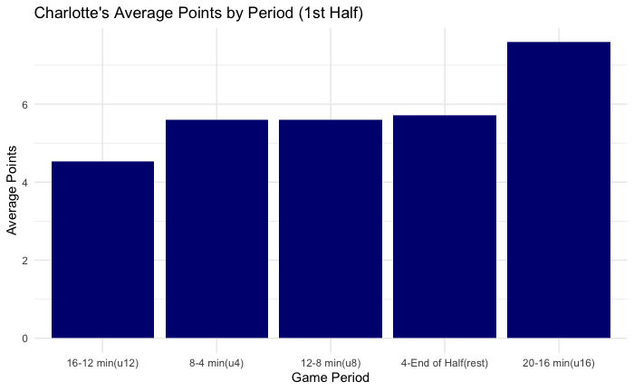
Charlotte’s Average Points in 1st Half
Insights: They score the most points during the u16 timeout period and score the least during the u12 period.
They are pretty consistent in scoring for the other 3 periods.

Slide 4
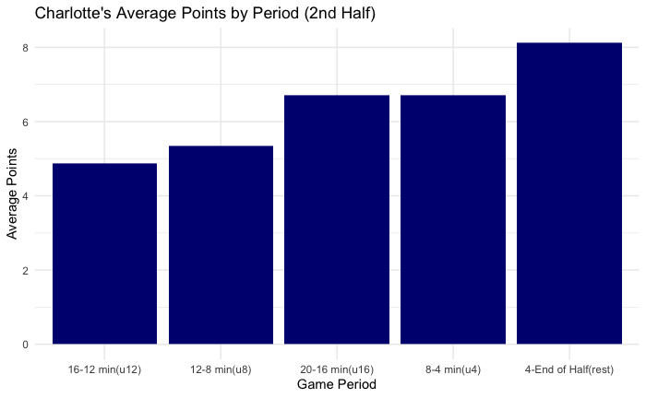
Charlotte’s Average Points in 2nd Half
Insights: In the second half they score the most points at the end of the game when it could potentially matter the most.
The under 12 time period is where they underperform in both halves; If they could improve scoring during this time it could lead to more wins.

Slide 5
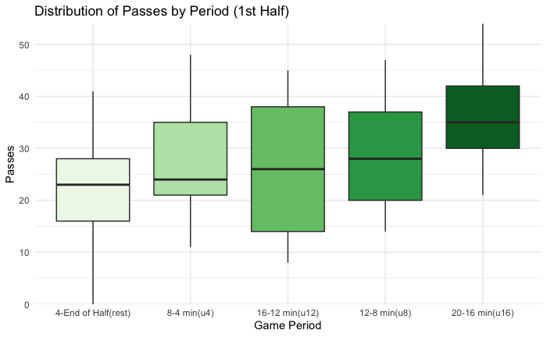
Distribution of Passes in 1st Half
Insights: The 20-16 min (u16) period has the highest median of passes during that time.
This is also when they score the most points on average. Early on they are passing the ball well and making the most of their passes. This is a good thing because in the beginning of the game you want to get everyone involved.

Slide 6
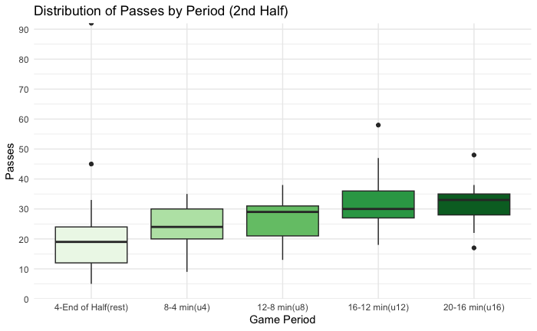
Distribution of Passes in 2nd Half
Insights: The lowest median of passes occurs in the time period under 4 minutes.
In this instance, the highest points scored on average happens when the least amount of passing occurs. So it could be an indicator of a lot more isolation basketball.
The outlier of 92 on the “rest” time period is due to a double overtime game against Temple.

Slide 7
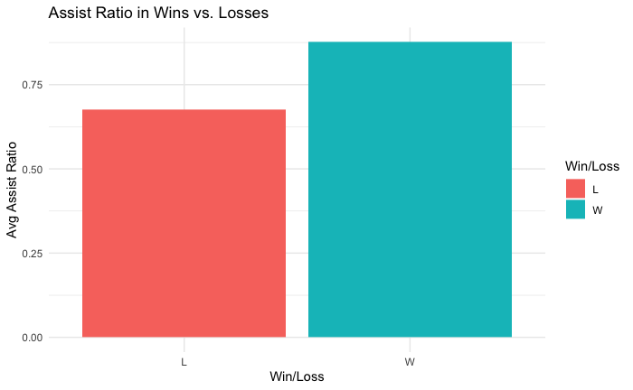
Assist Ratio In Wins vs. Losses
Insights: The assist ratio is significantly larger when they win games compared to when they lose.
Could be due to the sheer amount of opportunities they are getting or they are capitalizing well on the opportunities they do get.

Slide 8
THANK YOU!

